Slide 1
SS ZG 526: Distributed Computing
Deadlocks in Distributed Systems
Chittaranjan Hota
Professor, Dept. of Computer Sc. & Information Systems
BITS, Pilani Hyderabad Campus, Hyderabad
hota@hyderabad.bits-pilani.ac.in

Slide 2
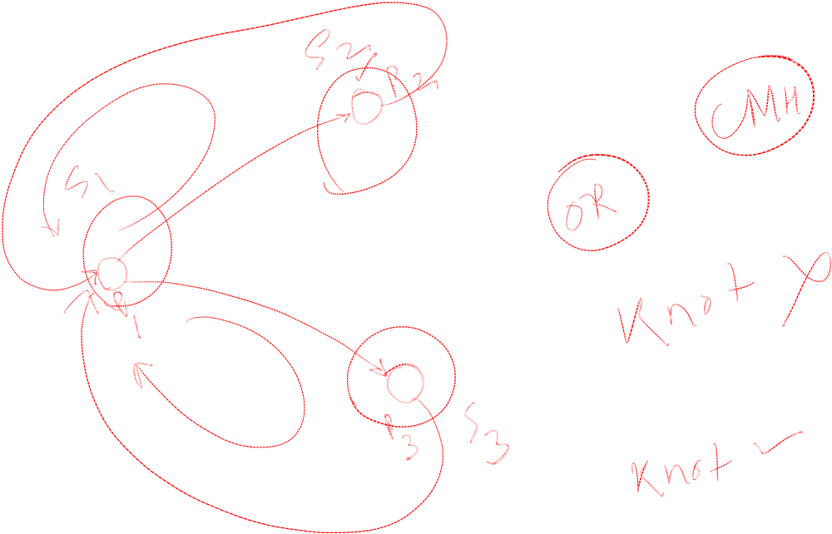
OR model graphs
Birla Institute of Technology and Science, Pilani (Deemed University)

Slide 3
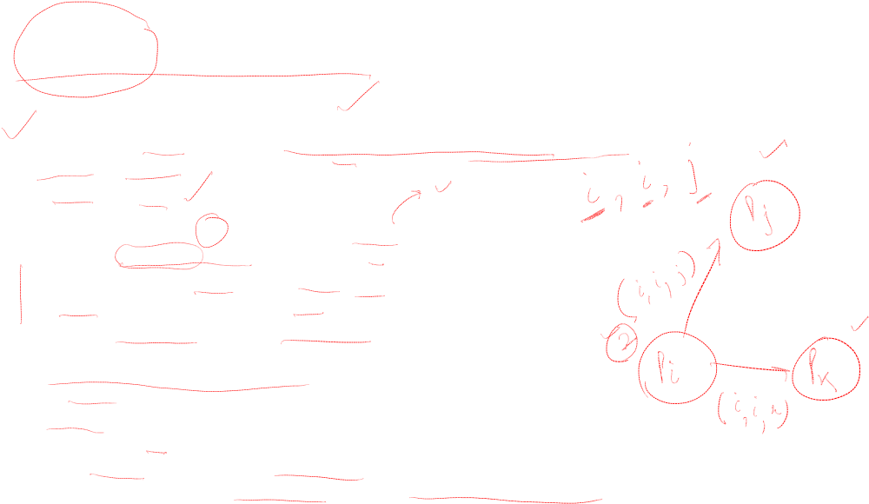
Diffusion Computation: Chandy-Misra-Haas Algorithm
1. Initiation by a blocked process Pi:
send query(i,i,j) to all processes Pj in the dependent set DSi of Pi;
num(i) := |DSi|;
waiti(i) := true;
2. Blocked process Pk receiving query(i,j,k):
if this is engaging query for process Pk /* first query from Pi */
then send query(i,k,m) to all Pm in DSk;
numk(i) := |DSk|; waitk(i) := true;
else if waitk(i) then send a reply(i,k,j) to Pj.
3. Process Pk receiving reply(i,j,k)
if waitk(i) then
numk(i) := numk(i) - 1;
if numk(i) = 0 then
if i == k then declare a deadlock.
else send reply(i, k, m) to Pm, which sent the engaging query.
Birla Institute of Technology and Science, Pilani (Deemed University)

Slide 4
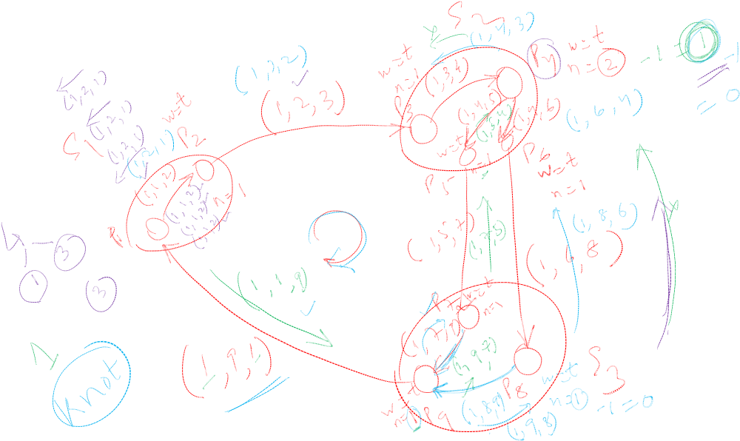
Example1 CMH OR model
Birla Institute of Technology and Science, Pilani (Deemed University)

Slide 5
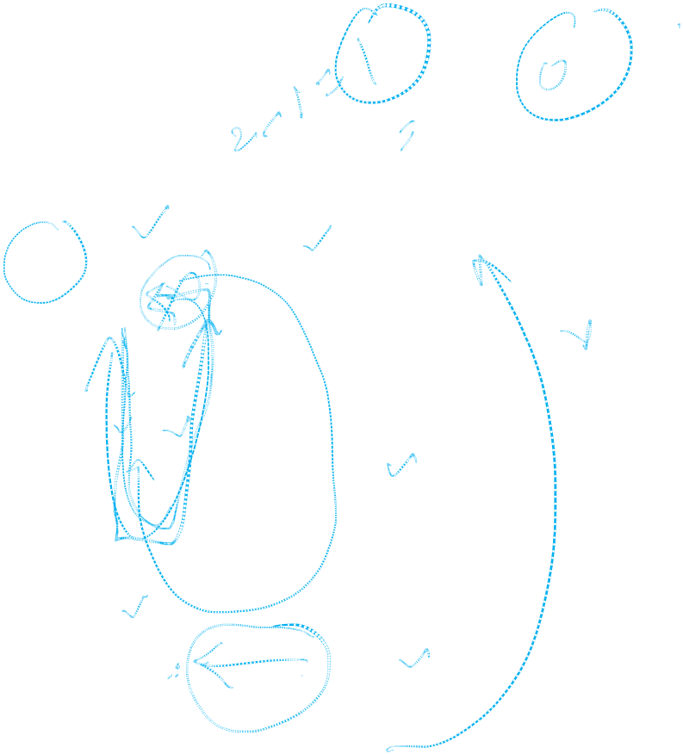
Example2 CMH OR model
P2
P1
P3
P4
P7
P6
P5
Birla Institute of Technology and Science, Pilani (Deemed University)

Slide 6

Persistence & Resolution
Deadlock persistence:
  Average time a deadlock exists before it is resolved.
Deadlock resolution:
  Aborting at least one process/request involved in the deadlock.
  Efficient resolution of deadlock requires knowledge of all processes and resources.
  If every process detects a deadlock and tries to resolve it independently → highly inefficient ! Several processes might be aborted.
Birla Institute of Technology and Science, Pilani (Deemed University)

Slide 7
Next module
Consensus/ Agreement Algorithms
Birla Institute of Technology and Science, Pilani (Deemed University)

